Slide 1
CANCER DETECTION USING Convolutional NEURAL NETWORKS
Under the guidance of :
Dr.K.M.VARAPRASAD Assoc.Professor NECN
Done by
K.Radha Krishna (17711A0567)
H.Nauman (17711A0565)
P.Venkata Nithish (17711A0589)
K.Vishnu Vardhan (17711A0569)
Sk.Suhail Basha (17711A05A1)

Slide 2
contents
Abstract
Introduction
Problem Statement
Literature Survey
Existing System
Proposed Systems
Architecture
UML Diagrams
Experimental Results
Conclusion
Future Scope
References

Slide 3
ABSTRACT
Cancer has been distinguished as a dangerous disease that has many different sub categories.
Machine learning is used widely in detection and diagnosis of cancer among patients.Here we are using Convolution neural networks to predict the cancer qualities. It is an algorithm to analyzing visual imagery.
Convolutional neural network is useful in analyzing visual imagery. In this project, we use Convolutional Neural Network models that take unstructured gene expression inputs such as images to classify tumors and non-tumor samples into their respected cancer types or as normal.

Slide 4
INTRODUCTION
Cancer is a group of diseases involving abnormal cell growth with the potential to invade or spread
to other parts of the body.
Hence Machine Learning is a field of AI in computer science which can implement many computational
intelligent techniques for the prediction of cancer at early stage if data of patient are collected.
In the view of providing better treatment to the patient, it is important to precisely predict different type
of tumours.

Slide 5
Problem Statement
Prediction of cancer is necessary at early stages. In existing system we are detecting
cancer but not accurately because in existing system specialists are needed to predict the
cancer.
Sometimes they may go wrong and leads to high damage of patients.
so, False detection takes place
To solve this problem we developed an accurate and efficient cancer detection system. It can be
very useful to give the accurate results.

Slide 6
LITERATURE SURVEY
Image denoising via combination anisotropic diffusion and bilateral filtering
M. Zeinali, S. Saryazdi, and H. Rafsanjani
This system uses mammogram images. It uses smoothening filters.
The system which can assist and help the doctor or specialist nurse to speed diagnosed the mammograms, to cover shortage of specialist or time handling diagnosed.

Slide 7
LITERATURE SURVEY (Contd)
2. Early Detection of Cancer: Past, Present, and Future by Joshua D Schiffman, Paul G Fisher, Peter Gibbs
The early diagnosis of a particular cancer type does not necessarily lead to higher rates of cure, and potential risks.
It is presumed that for each primary cancer there will be a typical window from the point at which ctDNA is initially detectable to when the lesion is incurable, a window that may be only a few months or may be several years, and potentially may vary widely within a particular cancer type.

Slide 8
EXISTING SYSTEM
1. The most common imaging method used to detect cancer and monitor its spread
is Computed Tomography (CT), which provides cross-sectional imaging by
computer CT scans are made using X-rays.
Magnetic Resonance Imaging (MRI) is a procedure that uses powerful magnetic fields. This does not generate ionising radiation. Situations where MRI is used include examining cancer or sarcoma in the head and neck region.
Ultra sound examination is useful for examining the cervix, pancreas, liver and kidneys. Needle biopsies can also be taken in ultra sound examinations

Slide 9
DISADVANTAGES IN EXISTING SYSTEM
False cancer detection is present while predicting the cancer.
Linked to a natural anxiety of specialists to avoid overlooking cancer images at earlier stages.
Some algorithms are not suitable for large data sets.

Slide 10
PROPOSED SYSTEM
Aim: The main aim of this project is to provide an automatic method for cancer prediction with accurate results.
Objectives:
To get the results of the diagnosis without any false predictions. It can predict the presence of the tumor in the body correctly.
The level of accuracy in the proposed system will be higher. All operation would be done correctly and it provide us the accurate results in the detection of the tumor.
We can detect the presence of the tumor in the body automatically just by providing and training the data to the system.
It does not require any experts help in predicting the cancer.

Slide 11
ADVANTAGES OF PROPOSED SYSTEM
Reducing the False results
Automatic Detection
Accuracy

Slide 12
SOFTWARE AND HARDWARE REQUIREMENTS
S/W Requirements:
• Operating System : Windows 7/8/10
• IDE : Juptyer notebook.
• Packages/Modules : Keras, Tensorflow, Matplotlib
Tkinter
• Technology : Python 3.6+.
H/W Requirements:
• Processor - I3/Intel Processor
• RAM - 8 Gb
Hard Disk - 40 Gb

Slide 13
ALGORITHM USED
CNN:
CNN uses two operations called ‘convolution’ and ‘pooling’ to reduce an image into its essential features, and uses those features to understand and classify the image
Convolutional Neural Networks are a bit different. First of all, the layers are organized in 3 dimensions: width, height and depth.
Lastly, the final output will be reduced to a single vector of probability scores, organized along the depth dimension.

Slide 14
PROPOSED METHODS
There are mainly 2 methods. They are as follows.
Feature Extraction:
In this part, the network will perform a series of convolutions and pooling operations during which the features are detected.
If you had a picture of a zebra, this is the part where the network would recognize its stripes, two ears, and four legs.

Slide 15
PROPOSED METHODS (Contd)
Classification:
Here, the fully connected layers will serve as a classifier on top of these extracted features.
It will assign a probability for the object on the image being what the algorithm predicts it is.

Slide 16
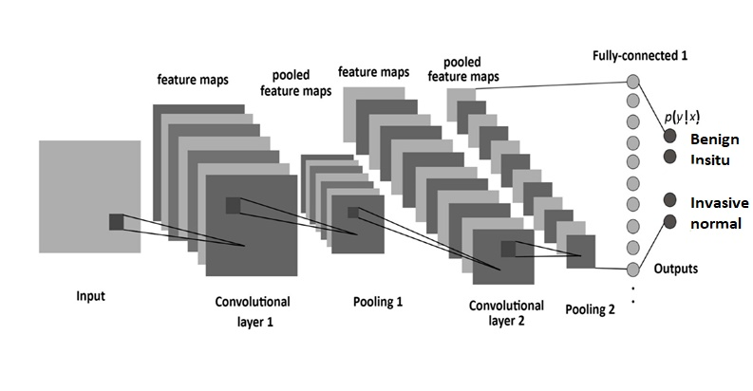
CNN ARCHITECTURE

Slide 17
UML DIAGRAMS
To design the project, we use the UML diagrams. The Unified Modelling Language (UML)
is a general- purpose, developmental, modelling language in the field of software engineering
that is intended to provide a standard way to visualize the design of a system.

Slide 18
CLASS DIAGRAM
In software engineering, a class diagram in the Unified Modeling Language (UML) is a type of static structure diagram that
describes the structure of a system by showing the system's classes, their attributes, operations (or methods), and the
relationships among the classes. It explains which class contains information.
System
Name: String
User
Take_Dataset ()
Upload testing image ()
Preprocessing ()
Cancer_detection ()
Training ()

Slide 19
SEQUENCE DIAGRAM
A sequence diagram in Unified Modeling Language (UML) is a kind of interaction diagram that shows how processes
operate with one another and in what order. It is a construct of a Message Sequence Chart. Sequence diagrams are
sometimes called event diagrams, event scenarios, and timing diagrams.

Slide 20
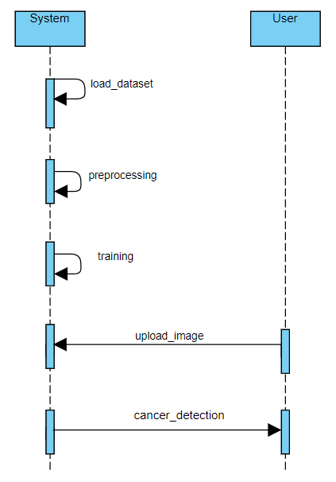
SEQUENCE DIAGRAM

Slide 21
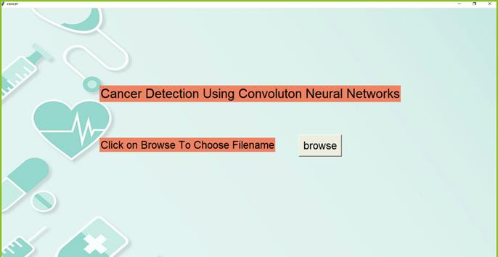
Experimental results

Slide 22
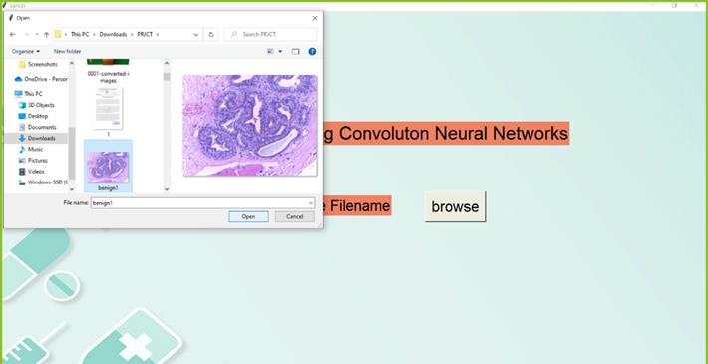
Experimental results (CONTD)

Slide 23
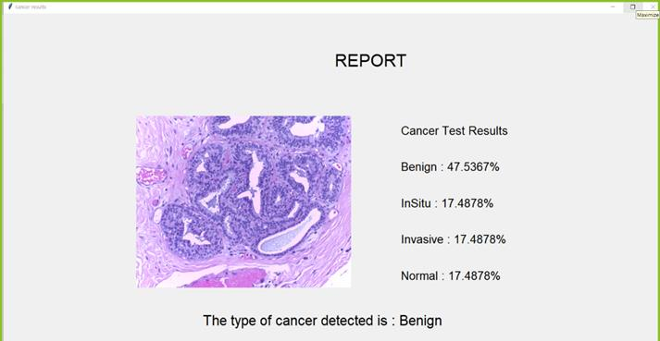
EXPERIMENTAL RESULTS (CONTD)

Slide 24
CONCLUSION
In this project, CNN architecture that take high dimension cancer image inputs and perform cancer type prediction while considering their tissue of origin. However with a simplified CNN construction and with a significant reduction from tissue of origin. This allows us to perform a normal interpretation of our CNN model to elucidate cancer markers for each cancer type, with hope in future refinement that will lead to markers for earlier cancer detection. Our model achieved an equivalent 95.6% prediction accuracy comparing to earlier published studies,.

Slide 25
FUTURE SCOPE
Convolutional neural networks (CNN) has a big scope in future and the biggest reason for it is that Deep Learning doesn’t require any kind of feature engineering. Deep Learning extracts the features from the data itself instead of us giving it the features after extracting it from the data. This way it solves our biggest problem of feature engineering. Also, since features are learned by the model itself, it has a better probability of producing a model which is more generalized than the feature engineered models.

Slide 26
REFERENCEs
Siegel RL, Miller KD, Jemal A: Cancer statistics, 2018. CA Cancer J Clin 2018, 68(1):7-30.
Cohen JD, Li L, Wang Y, Thoburn C, Afsari B, Danilova L, Douville C, Javed AA, Wong F, Mattox A et al: Detection
and localization of surgically resectable cancers with a multi-analyte blood test. Science 2018, 359(6378):926-930.

Slide 27
THANK YOU

